Slide 1
Open Table Mapping
Where can I go today?
James Lee

Slide 2
RoadMap
Purpose of This Project
Problems Encountered/ Solutions
The Map
Advantages?
Future Improvement

Slide 3



Purpose

Slide 4
RoadMap
Purpose of This Project
Problems Encountered/ Solutions
The Map
Advantages?
Future Improvement

Slide 5

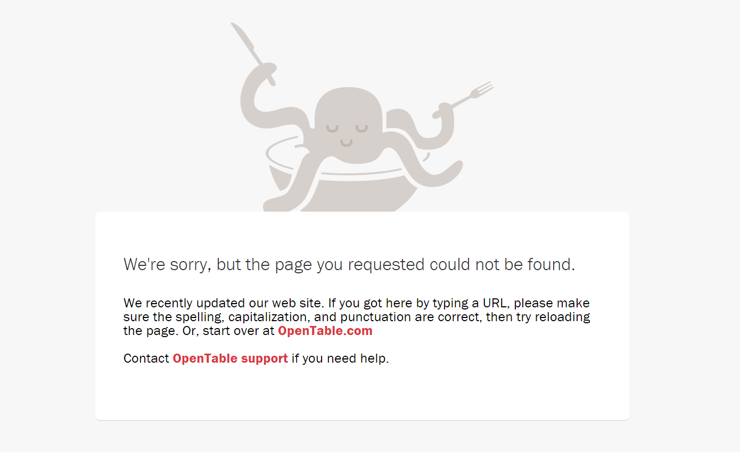
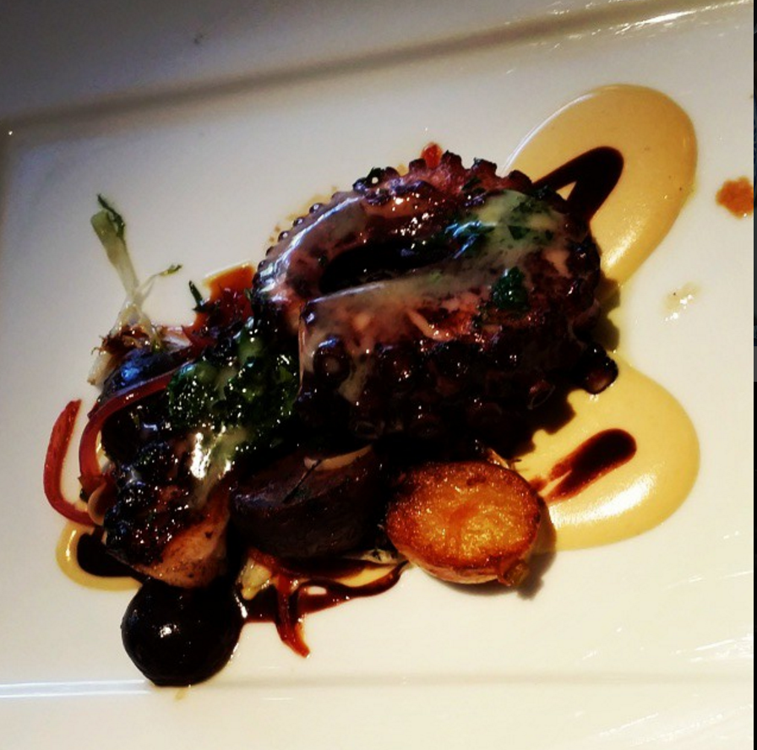
The Evil Octopus

Slide 6
The URL
www.opentable.com/ RestaurantName
www.opentable.com/r/ RestaurantName
www.opentable.com/r/RestaurantName-New-York
restaurantl = [re.sub('&', 'and',s) for s in restaurant]
restaurantl = [re.sub(' - ', '-', s) for s in restaurantl]
restaurantl = [re.sub(r'[^a-zA-Z0-9\s-]+', '', s) for s in restaurantl]
restaurantl = [re.sub(r'\s+', '-', s) for s in restaurantl]

Slide 7
I know this is New York. But…
Python unfortunately does NOT support accented letters ex: (á, é, í, ó, ú, ü, ñ)
xcuisine = driver.find_element(By.XPATH, '//*[@id="profile-details"]/div/div/div[1]/p[2]/span[2]').text
xcuisine = str(unicodedata.normalize("NFKD", xcuisine).encode('ascii','ignore'))

Slide 8
RoadMap
Purpose of This Project
Problems Encountered/ Solutions
The Map
Advantages?
Future Improvement

Slide 9

The Map

Slide 10
RoadMap
Purpose of This Project
Problems Encountered/ Solutions
The Map
Advantages?
Future Improvement

Slide 11
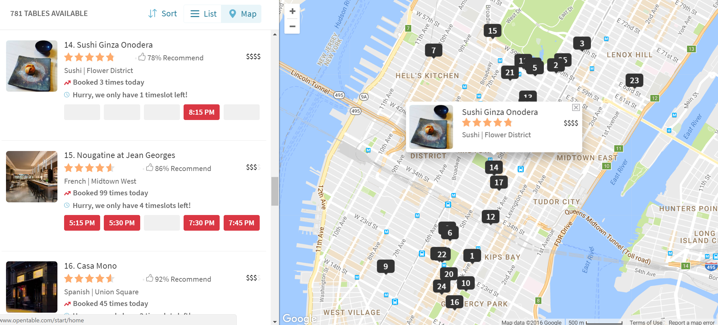
NONE
But Not For Long.

Slide 12
RoadMap
Purpose of This Project
Problems Encountered/ Solutions
The Map
Advantages?
Future Improvement

Slide 13
Planned Additions
Allow user input: Choose what time, what day to check (Multiple Inputs Too!)
Expand Beyond Manhattan
Be able to reserve instantly within the Map
Directions / Recommendations by Situation

